Slide 1
Analysis of March 2016 Twitter Data

Slide 2
Presentation Outline
Introduction to the data
Preprocessing
Methods of Analysis
Visual analysis of tweets
Network analysis of users
Topic modeling of tweets
Misspelled words analysis
Clustering based on user description

Slide 3
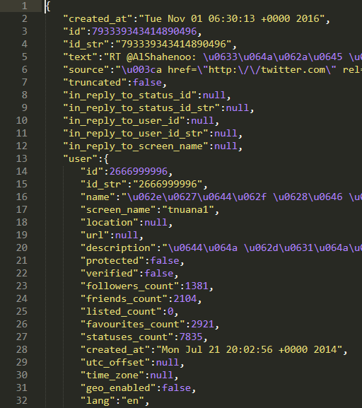
Introduction to the Data
One month of data – March of 2016
Each tweet is a single line json object.
Nested structure poses difficulties.
Contains a plethora of fields: the content of each tweet, amount of likes and favorites, time of posting, user characteristics, and many more
329 unique fields
Size of compressed data: 36.24gb

Slide 4
Pre-processing the tweets
Original Data
Size: 36.24GB compressed
Tweets: 107,430,615
Features: 329
Languages: All
First, we flatten each nested .json file.
Then we retrieve only the features that we might use.
329 features -> 96 features
Finally, we subset to only English tweets.
The processed data is still .json, not .csv. Why?
Processed Data
Size: 6.68GB compressed
Tweets: 27,786,026
Features: 96
Languages: English

Slide 5
Spark Cluster & Stack
Microsoft Azure allows easy setup of temporary Spark clusters through HDInsight.
Disadvantages:
Clusters can not be paused like Azure VMs. They must be deleted and reconfigured each time.
Prices - default cluster configuration costs $4/hr, lower performance nodes are cheaper
These require us to find a balance between price and performance.
Pre-processing requirements for different analytics performed are met using Spark with pyspark.
Even some of the analytics are performed end-to-end using spark ML engine.

Slide 6
Visual analysis of March Twitter data
We first seek to visualize our March twitter data. What can we gain from doing this?
We can see the distribution of our features with histograms
Tweets per user
Number of friends, followers, favorites, and statuses
We can watch how our features change over time with time series
Tweet and user frequency by week and month
We can tell at a glance the most common hashtags with a word cloud.
To do this, we can use regex to extract hashtags from tweets and determine the frequency of each hashtag, letting us build a word cloud.

Slide 7
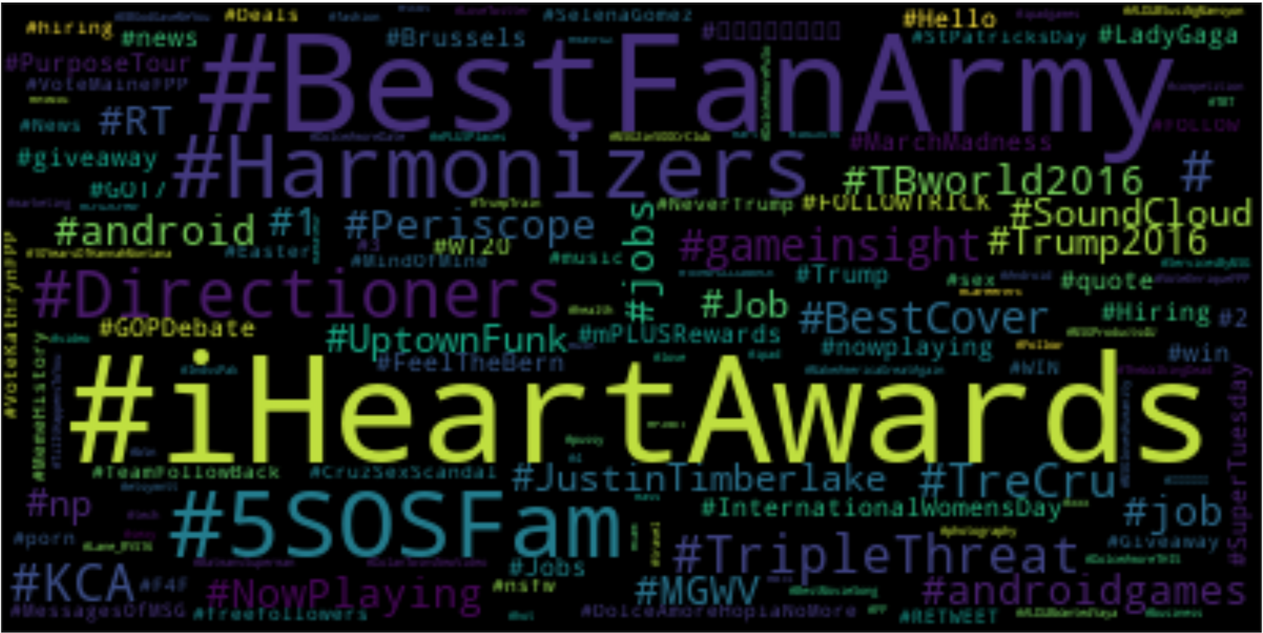
Hashtag Word Cloud

Slide 8
Network Analysis of Users
Large Scale Graph Mining using Spark
Graph theory for Social Networks
Application
Visualization
Analysis
Six degrees of separation
Phenomenon
Test
GraphFrames for PySpark
Retweet Network

Slide 9
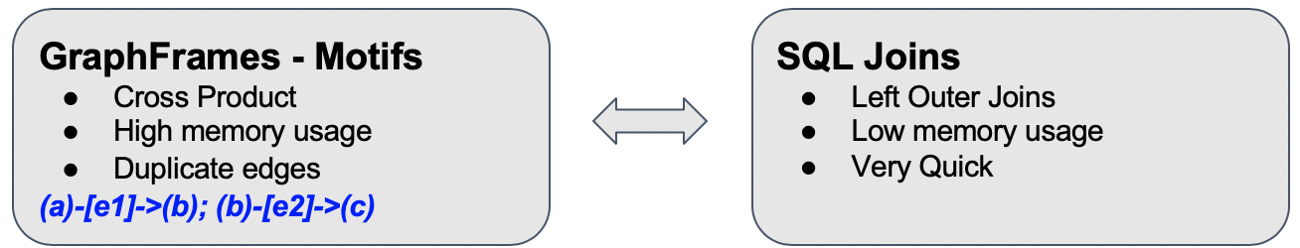
Pre-processing
Extraction of user relations based on retweets and quotes.
Extraction of most recent user information available in the data.
Handling of cases where both retweets and quotes are available for the same tweet.

Slide 10

Network Graph
Total Users from Retweet Network : 6,871,346
Selecting the top 10 most followed users.
Finding the degree of centrality for each of these users.
Selecting the user with highest degree of centrality.
User
User
User
User
User
User
User
User
User
User
User

Slide 11
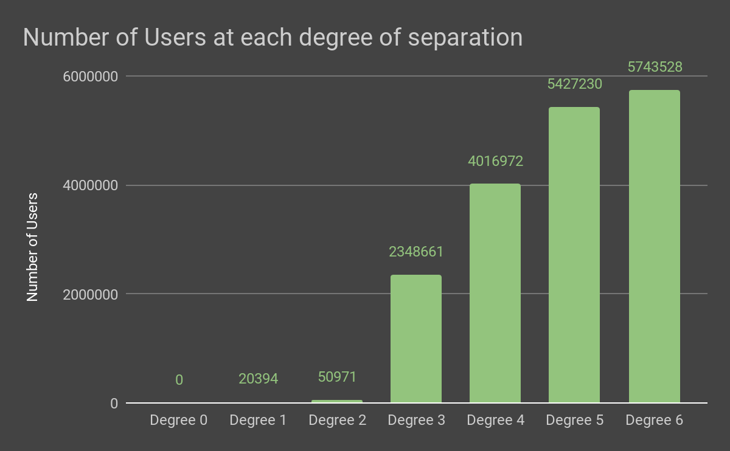
Total Number of Users at Degree 6: 5,743,528
83%

Slide 12
Topic modeling of tweets
The next goal for analysis is to determine the topic of a given tweet. How do we accomplish this?
Naive approach: manually assign labels or use hashtags, then use a supervised learning method
Better approach: use an unsupervised model to determine the underlying topics in our tweets, then assign labels based on these
Latent Dirichlet Allocation (LDA) does exactly this.

Slide 13
Topic modeling of tweets - LDA background
LDA first assumes that, in a collection of documents, there are finite n underlying topics. Further, we assume that each document is a combination of topics.
Then, LDA attempts to find these topics from the data, modeling each topic as an array of words with weights assigned to each word.
Hence, the ‘predicted topic’ for a tweet is actually a weighted list of topics.

Slide 14
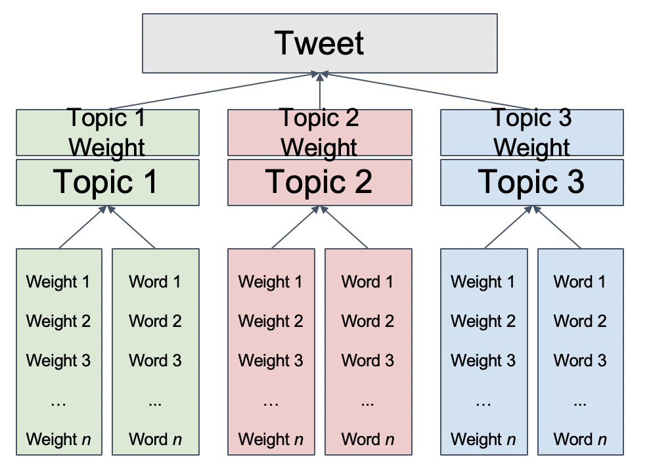
Topic modeling of tweets - illustration

Slide 15
Topic modeling of tweets - implementation
Preparation and analysis done almost exclusively with native pyspark libraries.
Each tweet is first cleaned and tokenized. Stop words and words below a certain length are removed.
Note: this means that some tweets are entirely excluded.
For each tweet, the term frequency - inverse document frequency (TF-IDF) is calculated.
The IDF helps minimize the effect of ubiquitous words.

Slide 16
Topic modeling of tweets - implementation
Using the TF-IDF, an LDA model is fit on the entire set of tokenized tweets. This returns a list of topics.
Next, the distribution of topics for each tweet is retrieved using the fitted model.
Sample output shown in the Notebook.

Slide 17
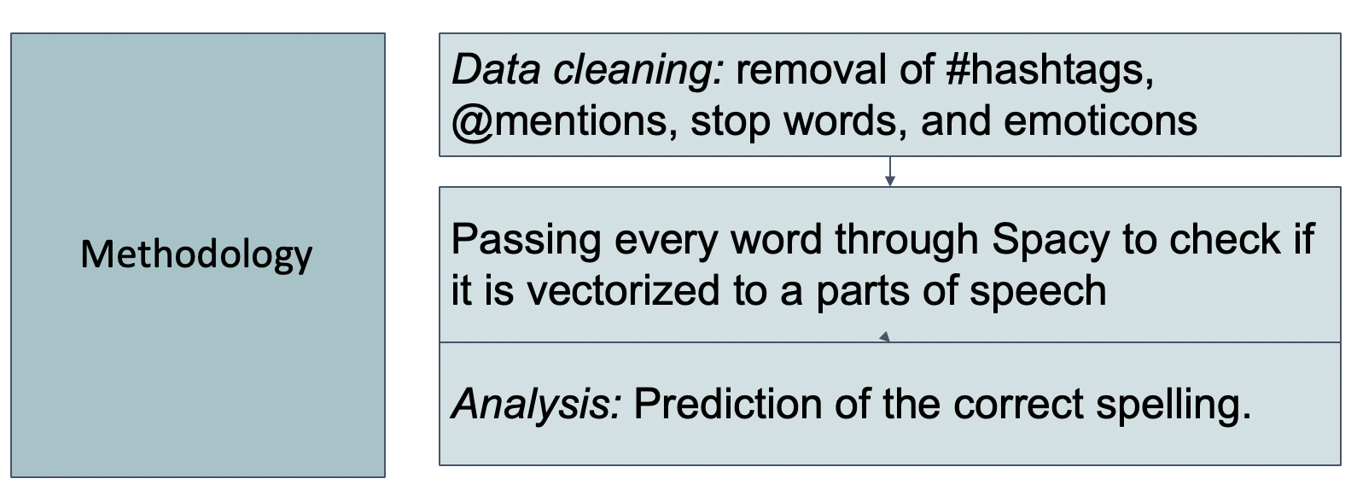
Misspelled words analysis
Objective: To find out the most misspelled words in the tweets, as well as the ways in which those words are misspelled.

Slide 18
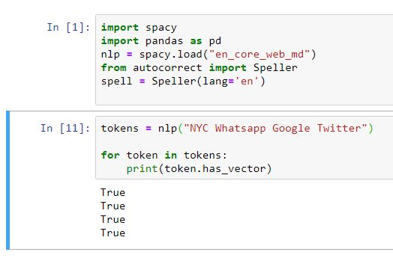
What is Spacy? and Why we are using it?
spaCy is a natural language processing library for Python.
Why spaCy?
spaCy can easily identify parts of speech. It can also identify names, organizations, and even abbreviations like “NYC.”
Model used: en_core_web_md
For every token, spaCy returns True if the word is recognized; i.e., spelled correctly.

Slide 19
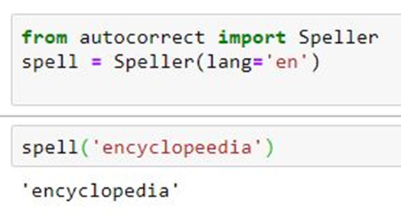
Misspelled words analysis - autocorrection
Utilized the library “autocorrect” to predict the correct spelling of a misspelled word.

Slide 20
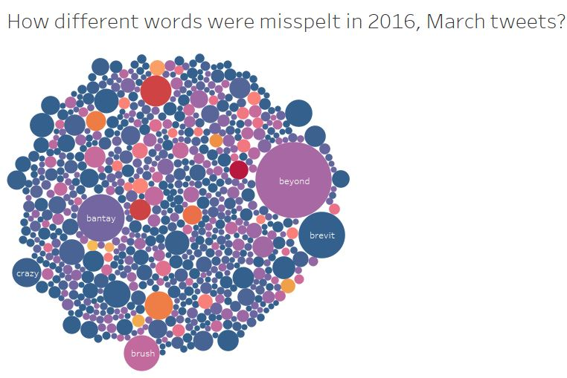
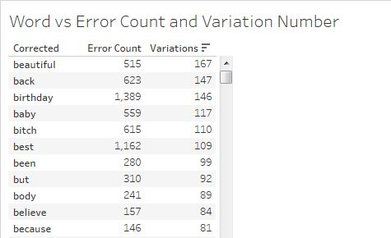
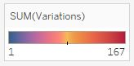
Observations
Plot: https://public.tableau.com/profile/nikhil.gupta2632#!/vizhome/March2016TwitterMisspellings/March2016TwitterMisspellings

Slide 21
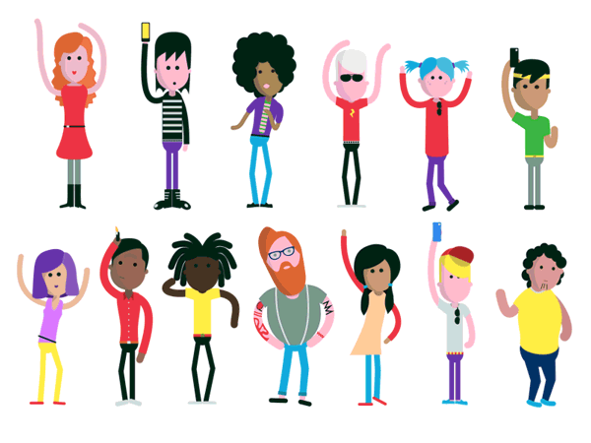
User Clustering
What kind of twitter users have we got?
So let’s see, if we can cluster similar users based on their profile description...

Slide 22
But Oops! The data is usually never straightforward
Not a chance if it is a Social Network profile description
Different Languages - ਟਵੀਟਰ ਡੇਟਾ ਮੈਂ ਨਹੀਂ ਕਰ ਸਕਦਾ ਹੈਂਗਲ
Stop words - the a was of at by for about
Emojis -😀 😁 😂 🤣 😃 😄 😅 😆 😉 😊 😋
Single Double Characters - h t i t gh ii yt ey bt
punctuations - @ % & * ) !

Slide 23
How to Cluster?
Using a simple, unsupervised machine learning algorithm: K-Means
But,
our input data is text...
VECTORIZE
The process of converting NLP text into numbers
Using TF - IDF over Count Vectorization because TF - IDF reflects importance of the word and not just the count.

Slide 24
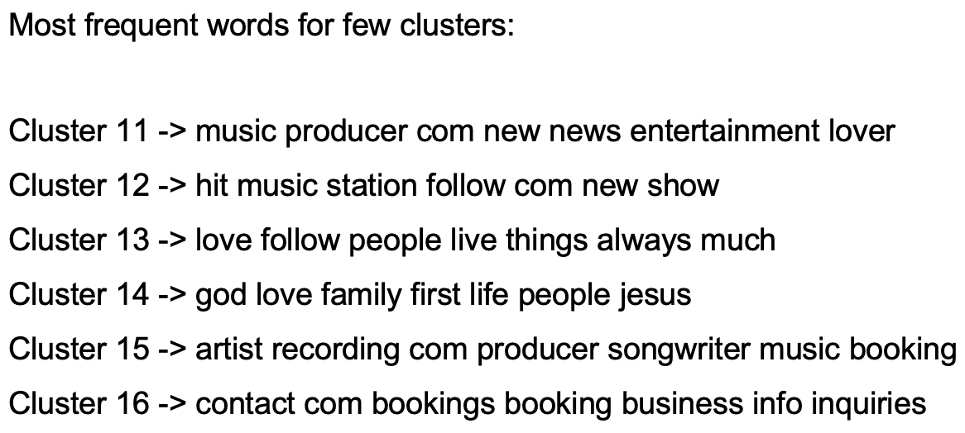
Let look to some clusters:

Slide 25
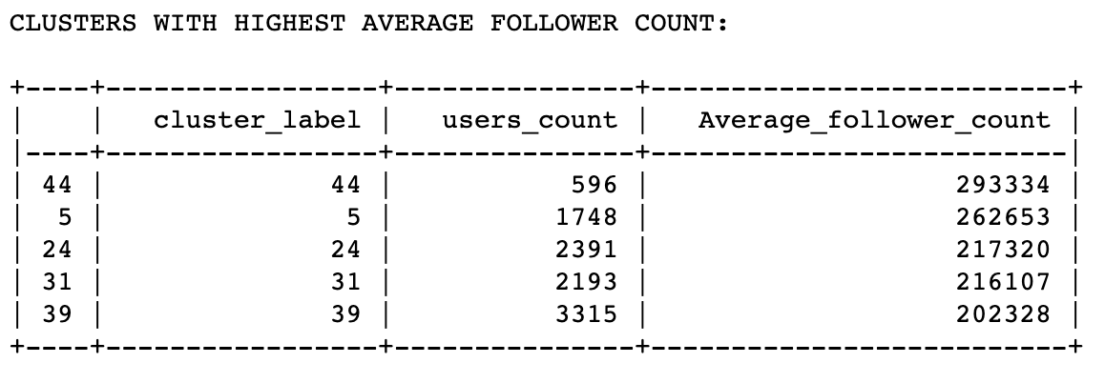
Now what?
Which clusters is most chased?
What’s in there in Cluster 44?

Slide 26
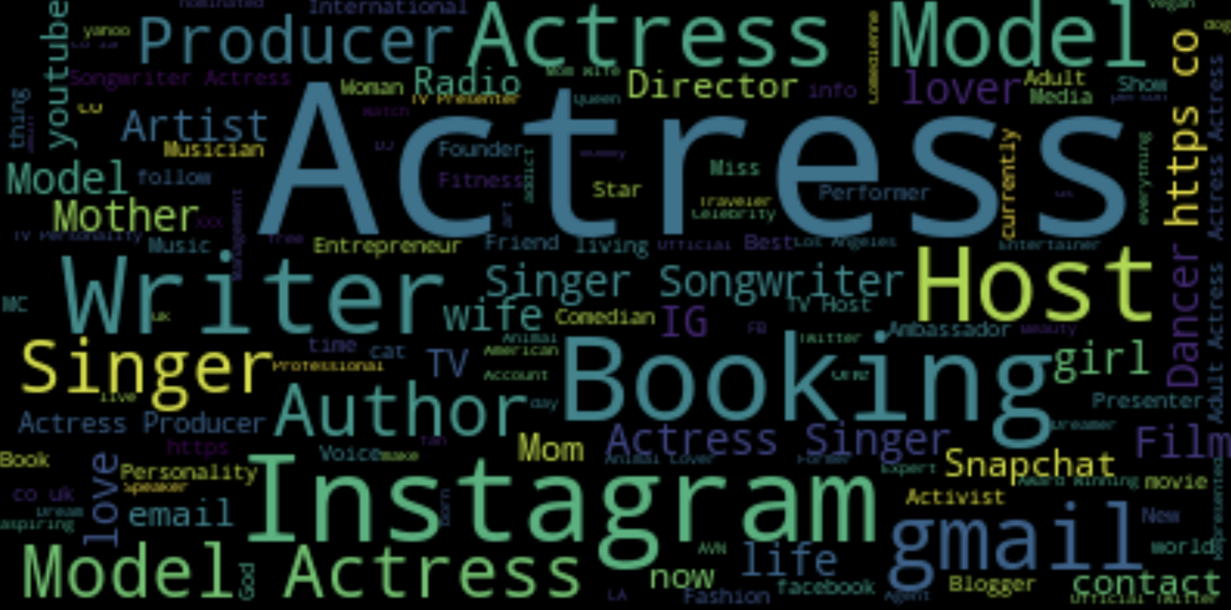
Word Cloud of Description

Slide 27
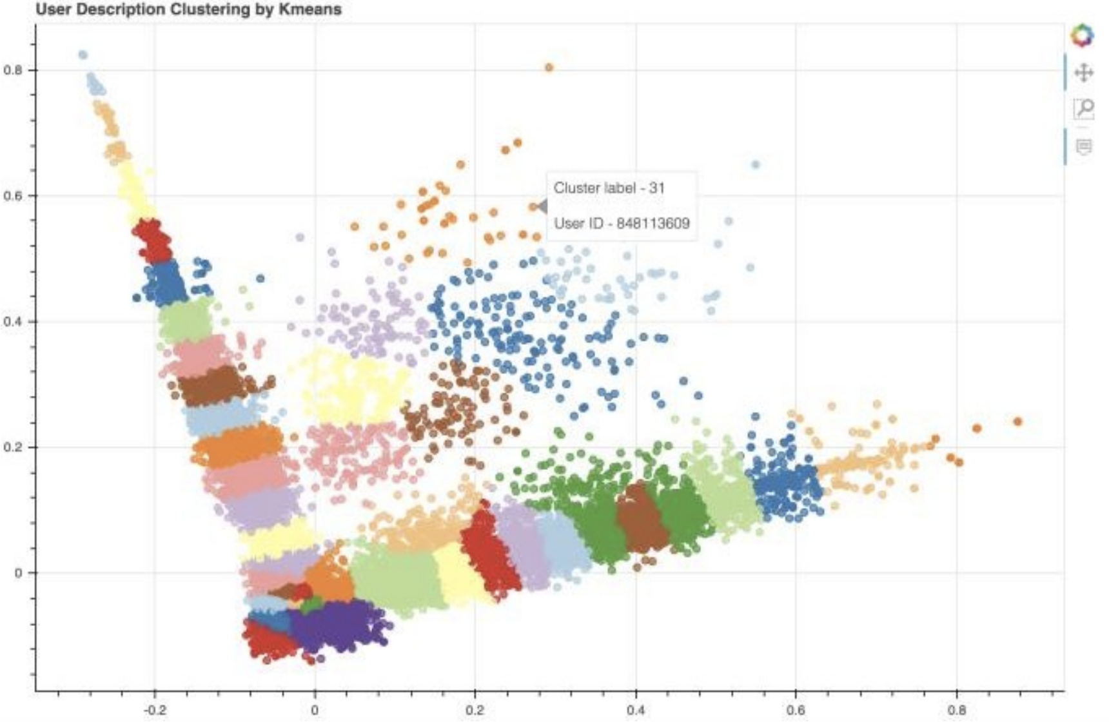
We want to visualize the users on a plot.
But there are so many dimensions
Let’s reduce the number of dimensions to 3 or less, to be able to visualize in a graph.
Principal Component Analysis

Slide 28
Questions/Concerns/Suggestions?
For any question, concern or suggestion please connect to me on Linkedin
https://www.linkedin.com/in/sonamdawani/

